Slide 1

business information systems (INFS1001) seminar - week 5
Devin Clementi Research School of Management (RSM) ANU College of Business and Economics The Australian National University devin.clementi@anu.edu.au

Slide 2
week 5 Agenda
Week 4 Review
Organisational Change
SDLC
Week 5 wrap-up
Ethics
The IT Organisation

Slide 3

Review
What are some of the advantages and challenges of the Agile methodology?
Describe some of the principles of Design Thinking.
What are the benefits and challenges of an ERP system?

Slide 4







The business information systems ecosystem Course Structure
In this course we examine how business information systems impact the inner workings of a business and the connections to a broader ecosystem.
Organisational Change
Decision Making
Markets
Systems Modelling
Technologies
Government
Systems Development
Data Management
Strategy Development Methods
Customers
Disruptive Tech
Cyber Security
Ethics
Suppliers
Competitors
The course focuses primarily on the areas of investigation listed above. By the end of the course, you should have at least an introductory level understanding of each of these areas.
This Photo by Unknown Author is licensed under CC BY-NC

Slide 5
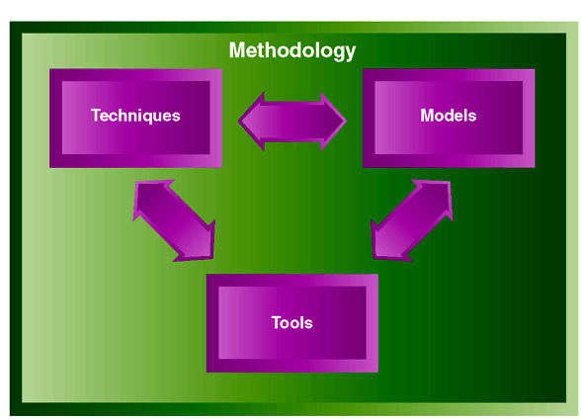
What is a system development Methodology?
When we implement or build a system, we follow a system development method.
The methodology determines how the system is built and drives the involvement of the IT and business area staff.
A system development method is a set of policies, procedures, standards, processes, tools, and tasks that people apply to technical and management challenges.
The System Development Lifecycle (SDLC) has changed significantly over the last 20 years.
Different software development methodologies include:
Waterfall structured methodology
Agile methodology, including
Rapid application development (RAD)
Extreme programming (XP) methodology
Scrum
Hybrid Waterfall and Agile
Prototyping

Slide 6
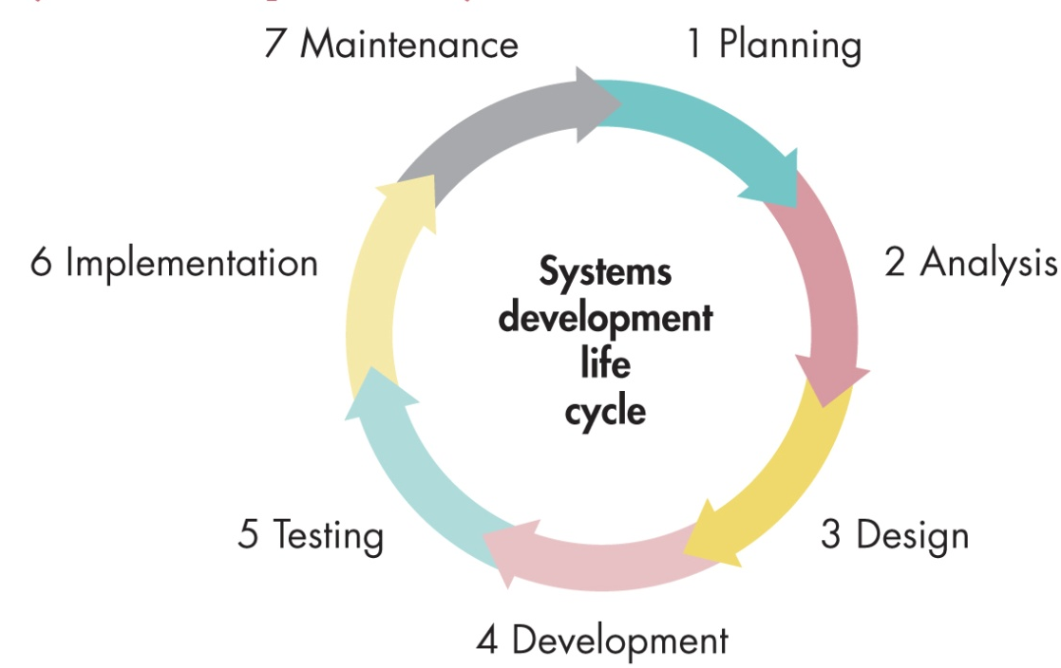
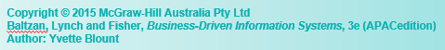
The Waterfall approach to the SDLC
Waterfall methodology is an activity-based process in which each phase in the SDLC is performed sequentially and relies on achieving each milestone with an obvious lack of timely feedback.
A very traditional development methodology that can be predictable but slow to provide insights into how the system will actually work.
Notes:
6

Slide 7
Developing the business architecture Principles of Design Thinking (DT)
Developing systems from requirements can be done in multiple ways.
Delivering value from technology in a business or social setting requires us to understand the requirements and the problem that we are trying to solve.
Historically, this is not something that IT professionals have done well.
Design Thinking provides a process that enables Business and IT to work together to solve some relevant, interesting problems.
Sometimes, you just have to ask the right question!!
d.school Bootcamp Bootleg. (2010). Hasso Platner, Institute of Design at Stanford.
What is Design Thinking?

Slide 8
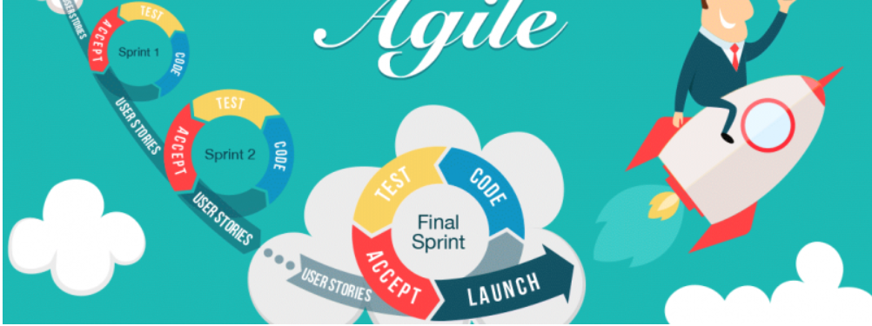
AGILE SOFTWARE DEVELOPMENT METHODOLOGIES
https://dev.esds.co.in/blog/2017/09/19/need-agile-methodology-web-development/
Agile methodology aims for customer satisfaction through early and continuous delivery of useful software components developed by an iterative process using the bare minimum requirements.
The four core values of Agile software development as stated by the Agile Manifesto are:
Individuals and interactions over processes and tools;
Working software over comprehensive documentation;
Customer collaboration over contract negotiation; and
Responding to change over following a plan.

Slide 9

The 12 principles of agile
Our highest priority is to satisfy the customer through early and continuous delivery of valuable software.
Welcome changing requirements, even late in development. Agile processes harness change for the customer's competitive advantage.
Deliver working software frequently, from a couple of weeks to a couple of months, with a preference to the shorter timescale.
Business people and developers must work together daily throughout the project.
Build projects around motivated individuals. Give them the environment and support they need and trust them to get the job done.
The most efficient and effective method of conveying information to and within a development team is face-to-face conversation.
Working software is the primary measure of progress.
Agile processes promote sustainable development. The sponsors, developers, and users should be able to maintain a constant pace indefinitely.
Continuous attention to technical excellence and good design enhances agility.
Simplicity--the art of maximizing the amount of work not done--is essential.
The best architectures, requirements, and designs emerge from self-organizing teams.
At regular intervals, the team reflects on how to become more effective, then tunes and adjusts its behavior accordingly.
Many organisations claim to do Agile but few do it well

Slide 10
The business information systems ecosystem Course Structure
In this course we examine how business information systems impact the inner workings of a business and the connections to a broader ecosystem.
Organisational Change
Decision Making
Markets
Systems Modelling
Technologies
Government
Systems Development
Data Management
Strategy Development Methods
Customers
Disruptive Tech
Cyber Security
Ethics
Suppliers
Competitors
The course focuses primarily on the areas of investigation listed above. By the end of the course, you should have at least an introductory level understanding of each of these areas.
This Photo by Unknown Author is licensed under CC BY-NC

Slide 11
The ethical impact of information technology
New technology often introduces ethical challenges that are often recognised but rarely resolved (at least initially)
Legislative and legal systems are typically reactive and often lag the evolution of technology e.g. online privacy, data security, consumer rights, etc.
So how should we deal with these ethical challenges particularly with disruptive technologies such as smartphones, facial recognition, social media, etc.?

Slide 12
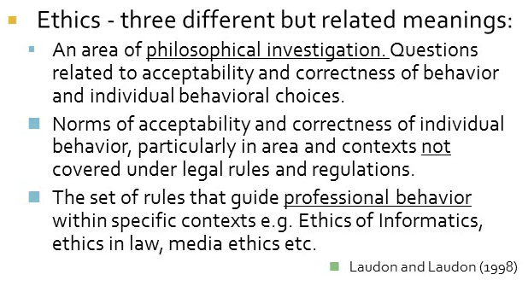
What do we mean by ethics?

Slide 13
Am I being ethical?
1. Would I be happy for this decision to be headlining the news tomorrow?
2. Is there an ethical non-negotiable at play?
3. Will my action make the world a better place?
4. What would happen if everybody did this?
5. What will this do to my character or the character of my organisation?
6. Is this consistent with my values and principles?
ANU says it is wrong to plagiarise or contract someone else to write your assignment.
What happens when we apply the guiding rules?
Have we demonstrated that these acts are unethical?

Slide 14

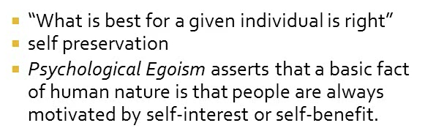
Ethical philosophies - egoism
Question – is the right to free speech an example of egoism?

Slide 15


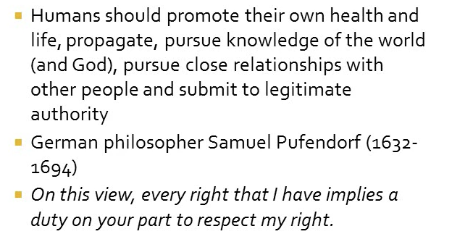
Ethical philosophies – natural law
In contrast to laws written by humans the philosophy of natural law proposes that there are laws that exist simply by participating in a natural system e.g. we all agree that using Artificial Intelligence (AI) to make a life and death decision is against natural law

Slide 16
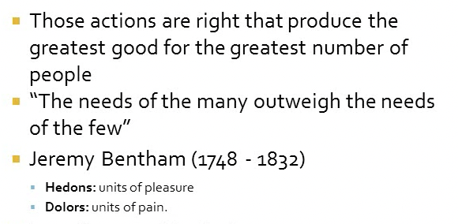
Ethical philosophies - utilitarianism
If we have limited technical resources the application of utilitarianism can guide the design and implementation of information systems – but is there a downside?

Slide 17
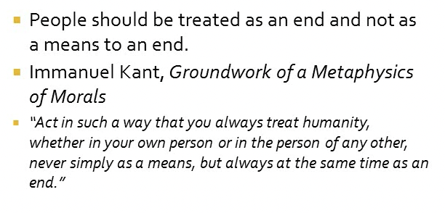
Ethical philosophies – respect for persons
Is collecting your personal information without consent unethical? Are you viewed as a person or a disembodied entity?

Slide 18
Identifying ethical concerns in business information systems
“the emergence of a wide variety of new technologies should give us a sense of urgency in thinking about the ethical (including social) implications of new technologies”
Security
Informed Consent
Privacy and Data Protection
Ambient Intelligence
IS Ethics
Ownership and trust
Technology dependency
Mis(uses) of Technology
Wakunuma, K. J., & Stahl, B. C. (2014). Tomorrow’s ethics and today’s response: An investigation into the ways information systems professionals perceive and address emerging ethical issues. Information Systems Frontiers

Slide 19
Australian computer society professional ethics
The Primacy of the Public Interest :You will place the interests of the public above those of personal, business or sectional interests.
The Enhancement of Quality of Life : You will strive to enhance the quality of life of those affected by your work.
Honesty: You will be honest in your representation of skills, knowledge, services and products.
Competence: You will work competently and diligently for your stakeholders.
Professional Development: You will enhance your own professional development, and that of your staff.
Professionalism: You will enhance the integrity of the ACS and the respect of its members for each other.
See also ACM Code of Ethics: https://www.acm.org/code-of-ethics

Slide 20
The ethics of artificial intelligence (AI)
As you listen to this video make notes describing the advantages of AI.
Identify the potential ethical challenges that may occur in our personal and professional lives.
What recommendations do you have to deal with these challenges?
Do you believe that the advantages outweigh the ethical risks?
Tom Gruber - Artificial Intelligence

Slide 21
In class discussion the ethical challenges of information systems
In this exercise you’ll apply two of the ethical philosophies to an identified technological capability.
Pick two of the following technologies and describe the ethical impact by applying the philosophies of Egoism and Utilitarianism.
Facial Recognition
Algorithms limiting information access
Wearable (or invasive) Technology
Social Media reporting

Slide 22
Infs1001 - The business information systems ecosystem
In this course we examine how business information systems impact the inner workings of a business and the connections to a broader ecosystem.
Organisational Change
Decision Making
Markets
Government
Systems Modelling
Technologies
Systems Development
Data Management
Strategy Development Methods
Customers
Disruptive Tech
Cyber Security
Ethics
Suppliers
Competitors
This Photo by Unknown Author is licensed under CC BY-NC

Slide 23
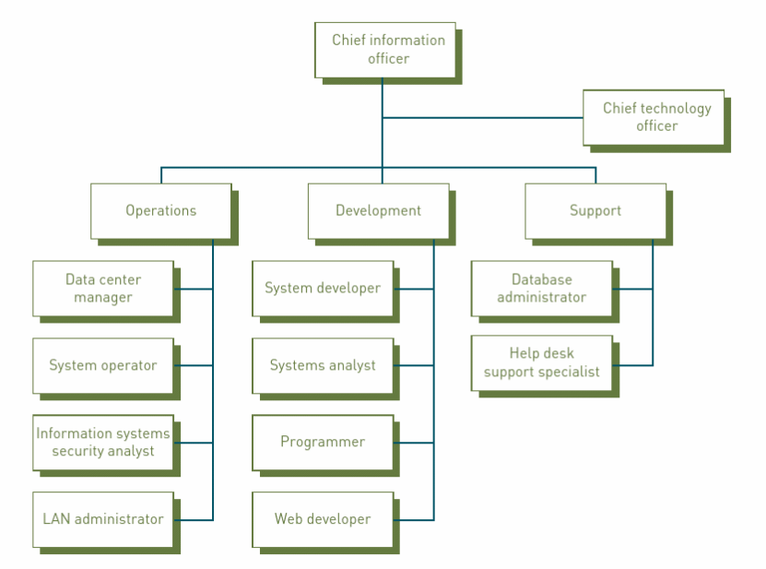
The it organisation – a traditional view
Traditionally the IT organisation relies on in-house skills and resources to provide technology support for the organisation.
The introduction of outsourcing, and cloud computing has changed the paradigm so that the “IT Department” now relies on external capabilities.
Figure 2.14 Stair, R. M., & Reynolds, G. W. (2014). Principles of Information Systems. Course Technology Cengage Learning.

Slide 24
The role of the CIO
The CIO role emerged in the 1980’s and the influence that they exert across the organisation varies widely.
Increasing reliance on technology to drive strategy and operational performance increase the relevance of the role which leads to larger IT budget.
This means there’s an even greater need for the CIO to be the executive connection between IT and the business.
They are often responsible for organisational performance not just service level agreements (SLAs).
The organisation’s focus often determines the nature of the CIO role.
For example:
Firms focused on strategic positioning often elevate the CIO so that they report directly to the CEO
In organisations that are cost focused, the CIO often reports to the CFO.

Slide 25

How do CIOs perceive their role?
“For years, CIOs have worked hard to make IT a utility where, like electricity, it just works. But now, CIOs are shifting from running a utility to being thoughtful business partners focused on business solutions. Our role will be to work with our business leaders to co-create the dream.” Will Lee, CIO of The Hanover
Digital transformation is not a one-time event,” he says. “By the time we are done implementing one wave, there will be a new one. CIOs are evolving from technologist and strategist to catalyst. Future CIOs will be evangelists of digital dexterity.” Deepak Kaul, CIO of Zebra Technologies
“The technology leaders of the future will have the technology depth and business acumen to be the bridge to value. Sanjib Sahoo, Chief Digital Officer of Ingram Micro
Martha Heller, C. (2022, October 19). What is the CIO's role today? redefining transformational it leadership. CIO. https://www.cio.com/article/409889/what-is-the-cios-role-today-redefining-transformational-it-leadership.html

Slide 26





A CIO challenge – How do we get Business and IT on the same page?
There is often a strained relationship between the IT department and the Business areas caused by:
Misaligned expectations
Missed deadlines
Poorly expressed requirements
Insufficient resources
Poor business area participation
Lack of executive support
What role do you think the CIO plays in bridging this gap?

Slide 27
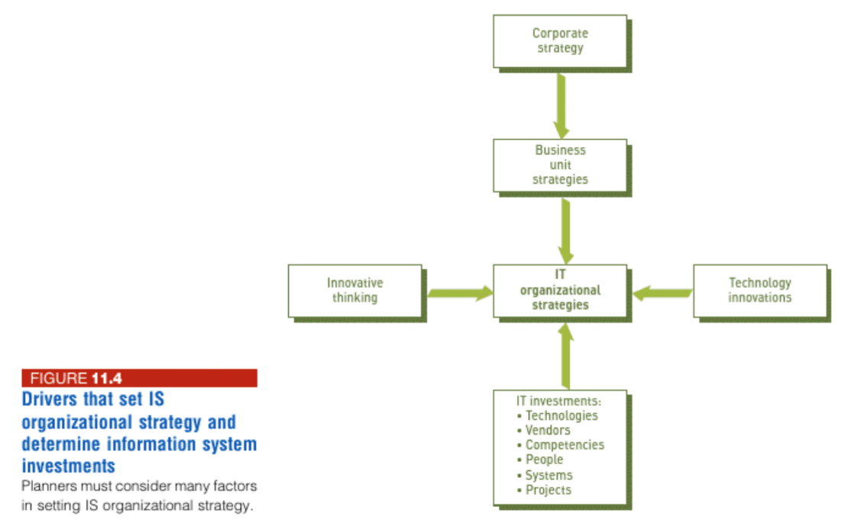
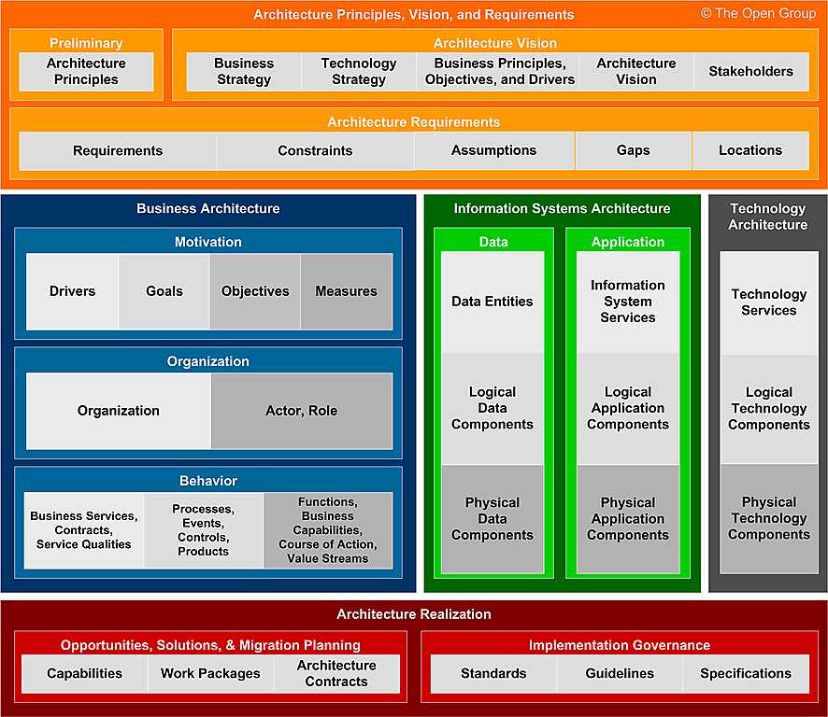

So, where’s the value in the it department?
Stair and Reynolds Figure 11.4
Value
Strategy
Business Alignment
Operations
Innovation

Slide 28

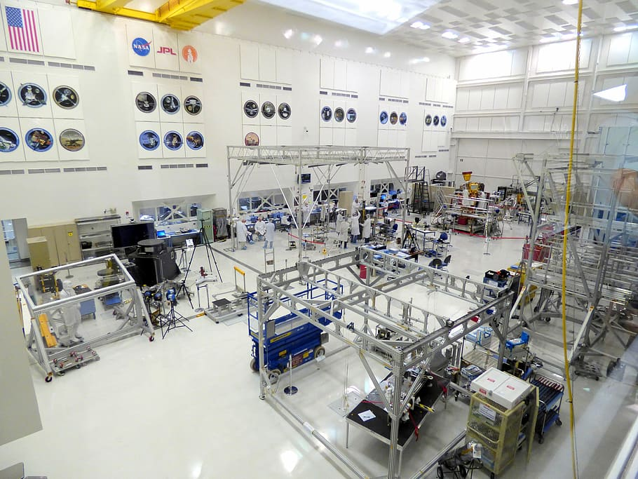
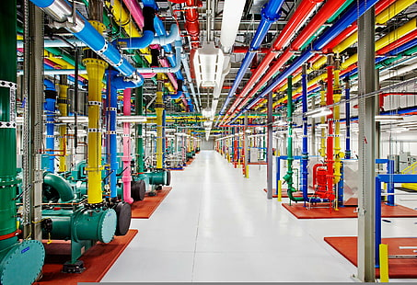
Operational support keeping the lights on
Historically the role of IT has been to ensure appropriate levels of operational support
Where appropriate, providing 24/7/365 access to the information systems needed to conduct business operations.
However, technology now plays a much larger role in the formation of strategy and operational planning.

Slide 29
But what about innovation?
Where does innovation come from?
How can you create a culture of innovation within the IT department?
Is it just innovation in information systems
What’s the value of innovation?
How does leadership impact innovation?
To help us understand innovation we can think of two types – Sustaining and Disruptive
Sustaining – “results in enhancements to existing products, services and ways of operating. Such innovations are important because they enable an organisation to continually increase profits, lower costs and gain market share”
Disruptive – “initially provides a lower level of performance than the marketplace has grown to accept. Over time, however, the disruptive innovation is improved to provide new performance characteristics becoming more attractive to users in a new market”
Stair, R. M., & Reynolds, G. W. (2014). Principles of Information Systems. Course Technology Cengage Learning. P. 52

Slide 30
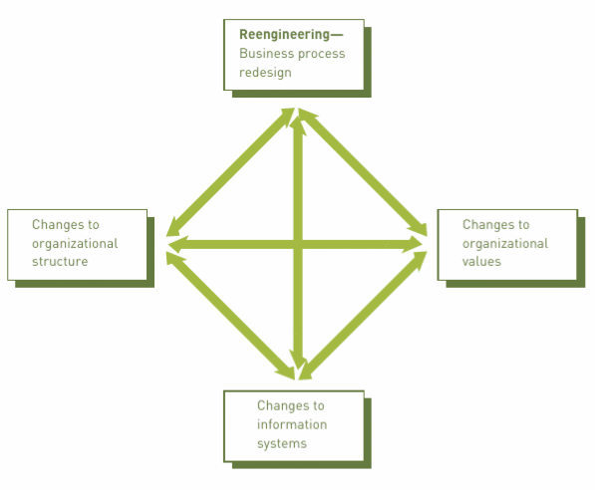
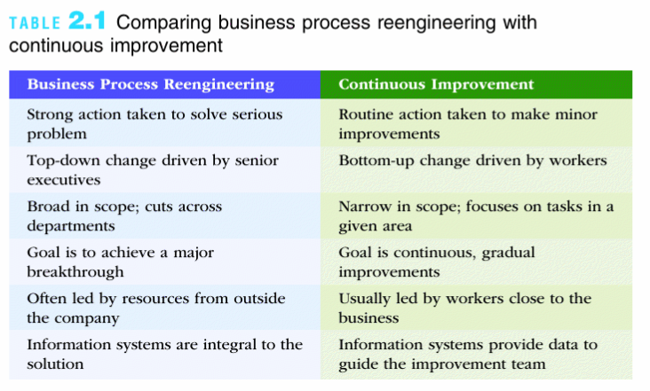
Leveraging innovation to drive organisational change
Organisations typically drive significant change through business process reengineering or continuous improvement
Driving change programs based on information systems is challenging for example - ERP project failures.
So how can organisations approach the implementation of successful change?

Slide 31
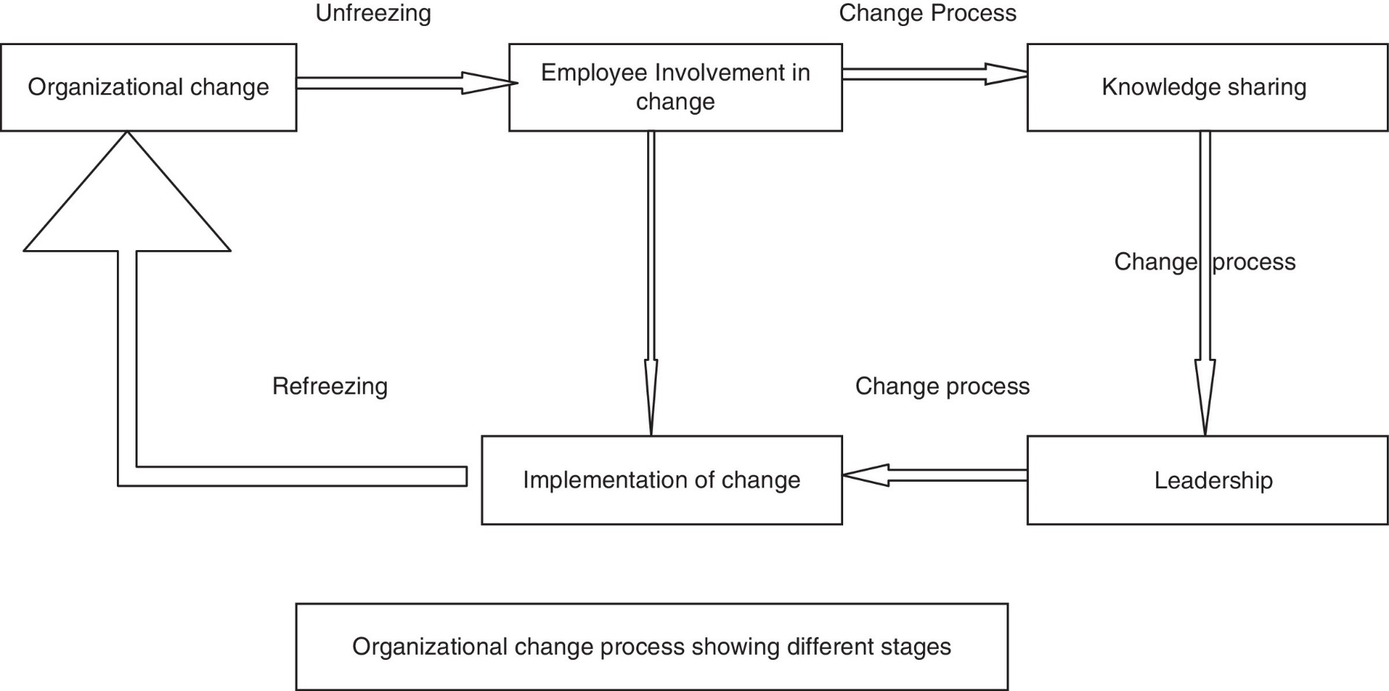
Driving organisational change
To successfully implement change, organisations create a sense of need and urgency that can only be solved through change.
The change model developed by Kurt Lewin talks about creating this need and urgency through three steps:
Unfreezing
Change or Transformation
Freezing
Syed Talib Hussain, Shen Lei, Tayyaba Akram, Muhammad Jamal Haider, Syed Hadi Hussain, Muhammad Ali,
Kurt Lewin's change model: A critical review of the role of leadership and employee involvement in organizational change, Journal of Innovation & Knowledge, Volume 3, Issue 3, 2018,

Slide 32



In class discussion – disrupting Netflix (20 minutes)
Netflix is now a dominant player in the streaming industry.
However, it wasn’t always the case.
Consider the following scenario and apply Lewin’s model to devise a strategy to help the organisation change its core business.
Think about the actors involved, their motivation and what will incentivize them to change.
Its 2006 and Netflix has a booming business in the DVD industry.
They have captured the market and established themselves as the dominant player in an industry that distributes entertainment content by mailing DVDs to its customers.
However, the executive management recognise that the industry is changing and moving more towards the online delivery of the same content.
But they have invested heavily in warehouses, distribution systems and their employees are very comfortable with the current model.
How can they begin to implement the change to online distribution and keep their current operation intact (at least for the time being)?
(FYI – Netflix shipped its last DVD on September 29th, 2023.)
Photo Credit – The Guardian
Photo Credit - ABC News

Slide 33

Mid semester quiz
The quiz is one hour in duration and consists of 80 multiple choice or drag/drop questions.
This quiz is online (via Wattle) and will cover all material up to and including Week 5.
Students must attend the quiz in person, with their student ID, and a password will be required to access the Quiz. Attendance will be taken.
Each question is worth one mark and students will not lose a mark for incorrect answers. The published grade for the quiz will be scaled to be out of 100.
It is your responsibility to ensure that you have good connectivity.
Students are required to stay in the seminar room until the quiz is closed even if they have finished the quiz.
There are no extensions for this assessment.

Slide 34
Infs1001 - The business information systems ecosystem
In this course we examine how business information systems impact the inner workings of a business and the connections to a broader ecosystem.
Organisational Change
Decision Making
Markets
Government
Systems Modelling
Technologies
Systems Development
Data Management
Strategy Development Methods
Customers
Disruptive Tech
Cyber Security
Ethics
Suppliers
Competitors
This Photo by Unknown Author is licensed under CC BY-NC

Slide 35
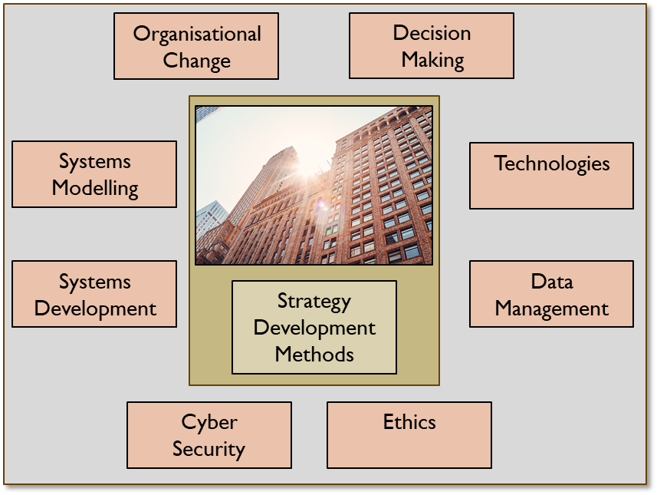

Course overview (1 of 2)
Strategy Development Methods
Business Model Canvas
Digital Strategy Diamond
Systems Modelling
General Systems Model
Systems Development
Agile
Waterfall
IT Strategy
Social Media Strategies
Rich Picture
Enterprise Architecture: TOGAF (organization)
Design Thinking
Organisational Change
Leadership Style (Transformational, Transactional, etc.)
Lewin’s model and force field analysis
SWOT
IT Organisation and Role of the CIO
The Value of IT
Tuckman
e-Commerce models

Slide 36
Course overview (2 of 2)
Technologies
Enterprise Resource Planning (ERP)
Cloud
Decision Making
Simon’s model
Heuristics
Structured, Semi structured, Unstructured
Emerging and Disruptive
Artificial Intelligence
Data Management
Data Management Strategy
Information Architecture
MIS/Balanced Scorecard
Cyber Security
Threat Types
Ethical Hacking
Data Breaches
Risk Management Strategy
VR and AR, Metaverse, Quantum, IoE
Data Hierarchy
Ethics
Egoism
Utilitarianism
Natural Law
Respect for Persons

Slide 37
week 5 – wrap up
In Week 5, we covered the following:
The IT Organisation
Driving Organisational Change
Keep reviewing for the Mid Semester quiz
Keep working on your BAR.
Good luck next week !!
and then have a good break…. ☺
BAR Discussion

